Slide 1
Exception Handling in Java

Slide 2
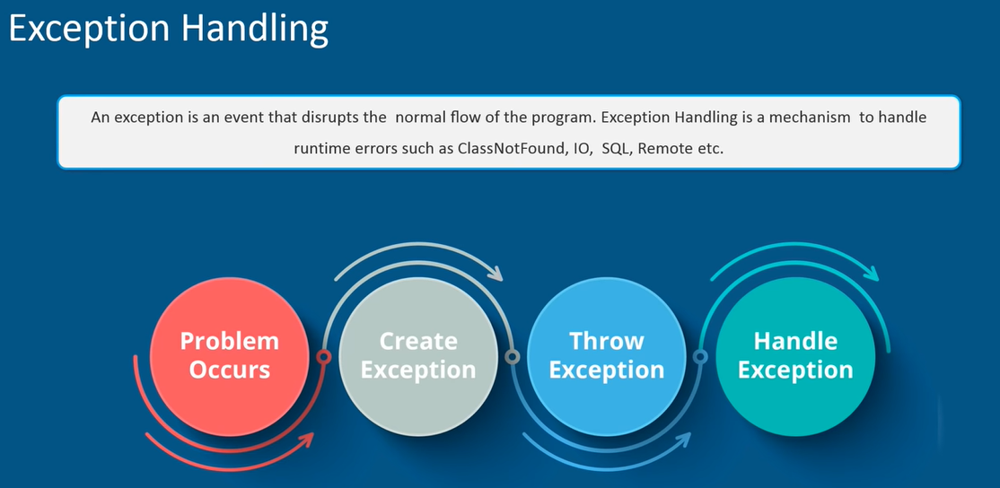

Slide 3
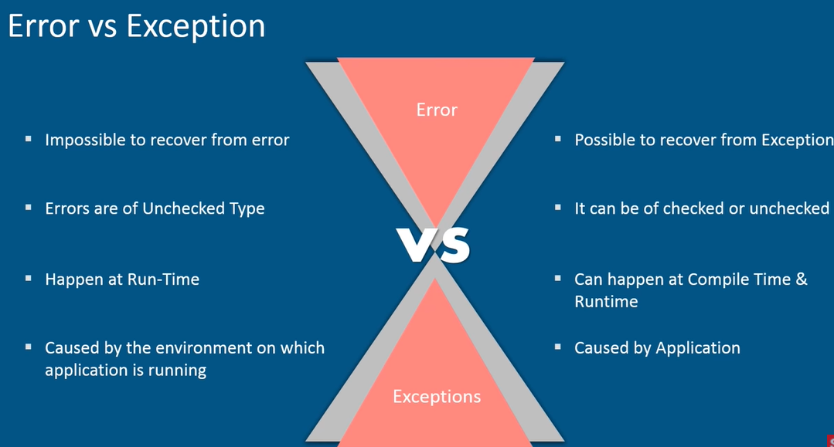

Slide 4
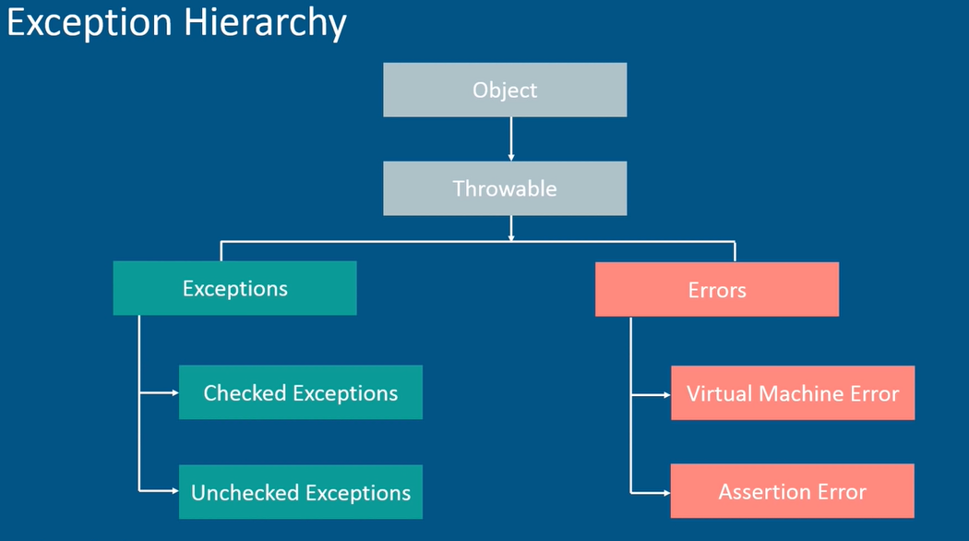

Slide 5
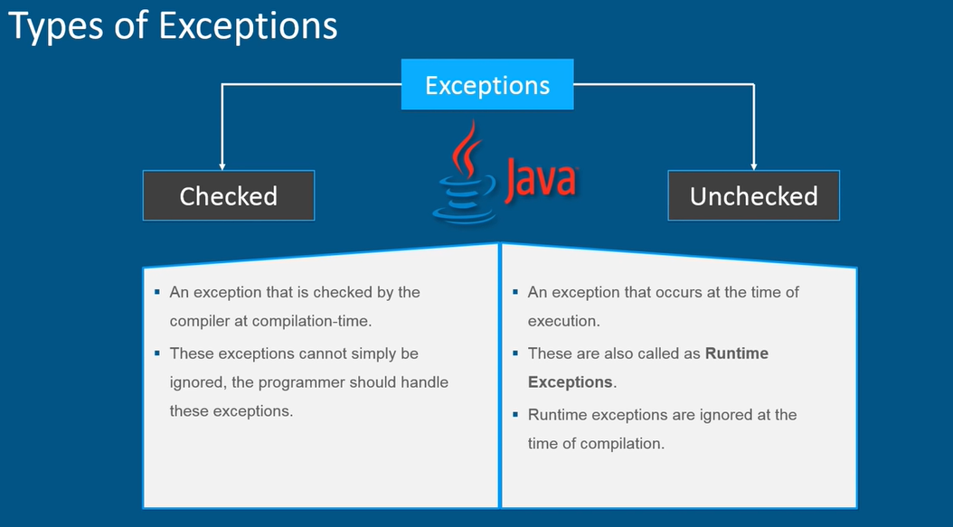

Slide 6
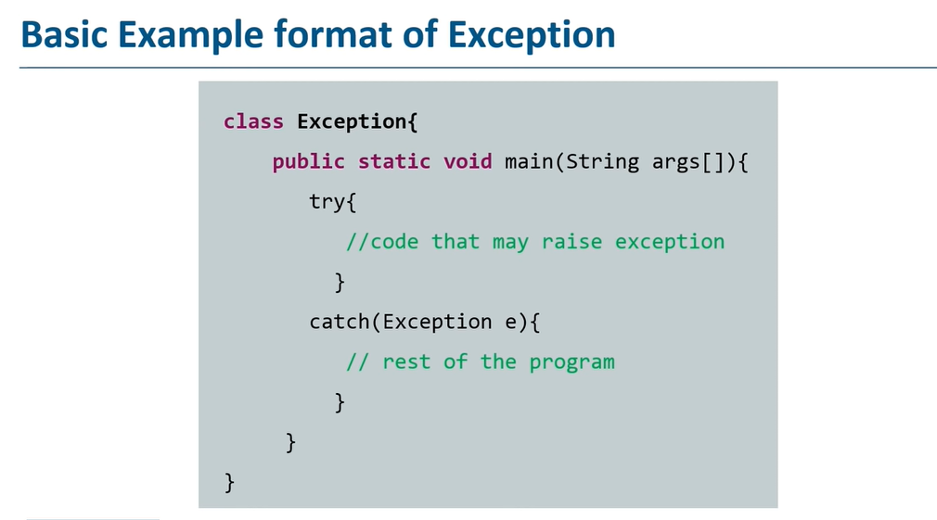

Slide 7
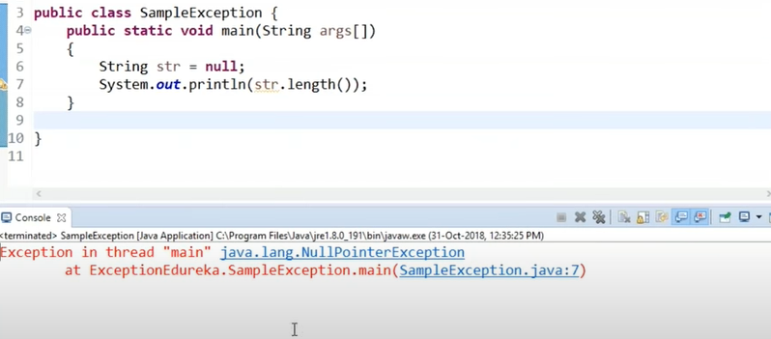

Slide 8
public class Main{
public static void main(String[] args) {
try
{
String str=null;
System.out.println(str.length());
}
catch(NullPointerException e)
{
System.out.println(e.getMessage());
}
}
}

Slide 9
public class Test {
public static void main(String[] args) {
try
{
int data=50/0; //may throw exception
}
//handling the exception
catch(ArithmeticException e)
{
System.out.println(e);
}
}
}

Slide 10
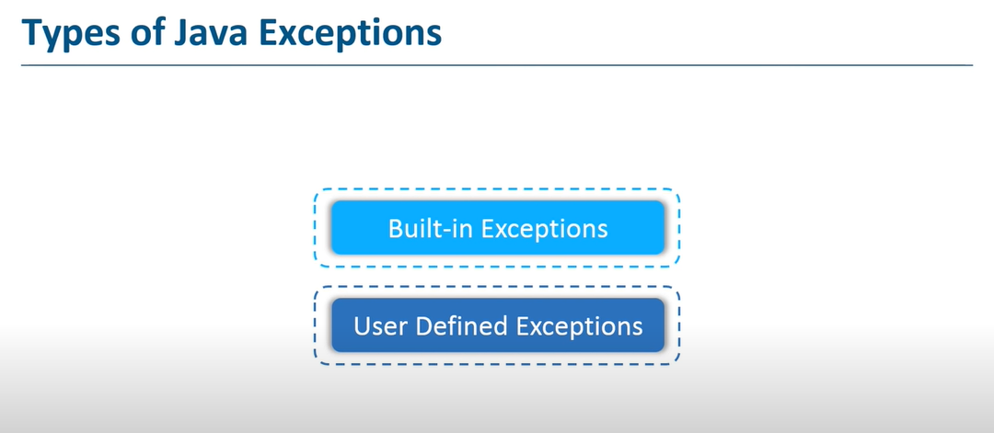

Slide 11
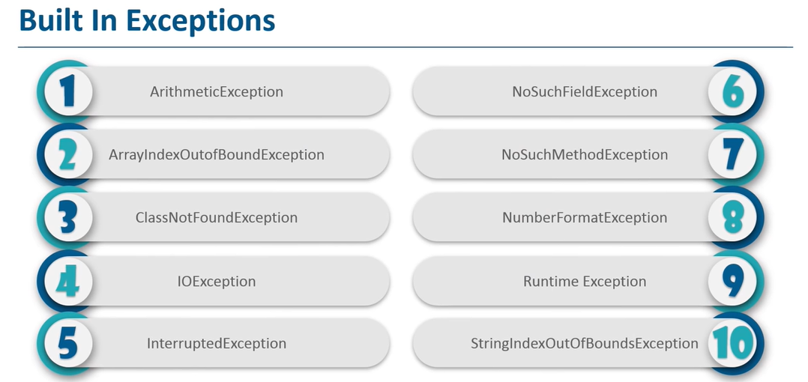

Slide 12
ArithmeticException
public class ArithmeticException_Demo
{
public static void main(String args[])
{
try {
int a = 30, b = 0;
int c = a/b; // cannot divide by zero
System.out.println ("Result = " + c);
}
catch(ArithmeticException e) {
System.out.println ("Can't divide a number by 0");
}
}
}
Output :
Can't divide a number by 0

Slide 13
NumberFormat Exception
public class NumberFormat_Demo
{
public static void main(String args[])
{
try {
int num = Integer.parseInt (“SCOE") ;
System.out.println(num);
}
catch(NumberFormatException e) {
System.out.println("Number format exception");
}
}
}
Output :
Number format exception
// The method generally used to convert String to Integer in Java is parseInt(). This method belongs to Integer class in java.lang package.

Slide 14
NullPointer Exception
//Java program to demonstrate NullPointerException
public class NullPointer_Demo
{
public static void main(String args[])
{
try {
String str = null; //null value
System.out.println(str);
}
catch(NullPointerException e)
{
System.out.println("NullPointerException..");
}
}
}
Output :
NullPointerException..

Slide 15
StringIndexOutOfBound Exception
public class Main
{
public static void main(String args[])
{
try {
String a = “Hello scoe"; // length is 10
char c = a.charAt(15); // accessing 15th element
System.out.println(c);
}
catch(StringIndexOutOfBoundsException e)
{
System.out.println("StringIndexOutOfBoundsException");
}
}
}
Output:
StringIndexOutOfBoundsException

Slide 16
FileNotFound Exception
import java.io.File;
import java.io.FileNotFoundException;
import java.io.FileReader;
public class File_notFound_Demo {
public static void main(String args[])
{
try {
// Following file does not exist
File file = new File("E://file.txt");
FileReader fr = new FileReader(file);
}
catch (FileNotFoundException e) {
System.out.println("File does not exist");
}
}
}
Output :File does not exist

Slide 17
ArrayIndexOutOfBounds Exception
public class ArrayIndexOutOfBound_Demo
{
public static void main(String args[])
{
try{
int a[] = new int[5];
a[6] = 9; // accessing 7th element in an array of size 5
}
catch(ArrayIndexOutOfBoundsException e){
System.out.println ("Array Index is Out Of Bounds");
}
}
}
Output :
Array Index is Out Of Bounds

Slide 18
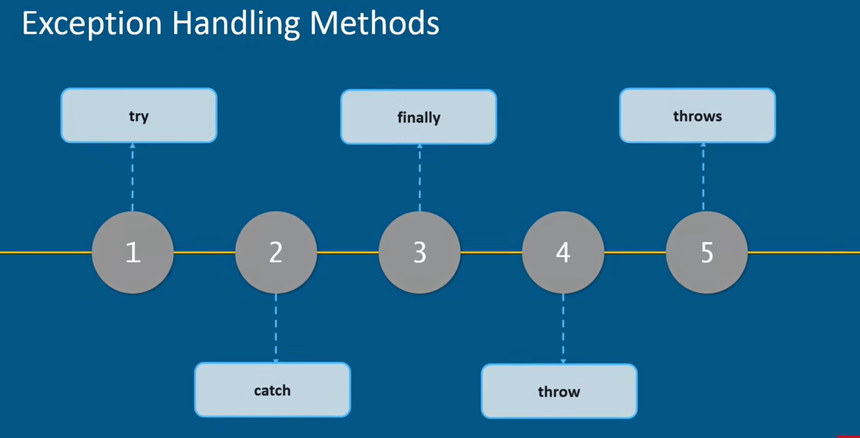

Slide 19
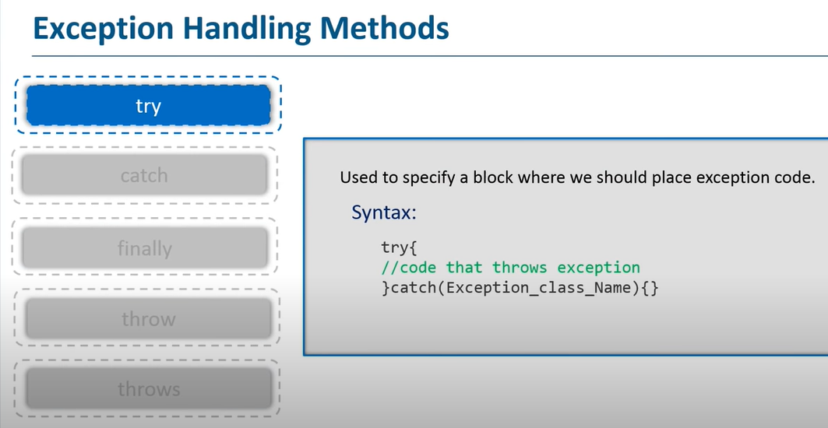

Slide 20
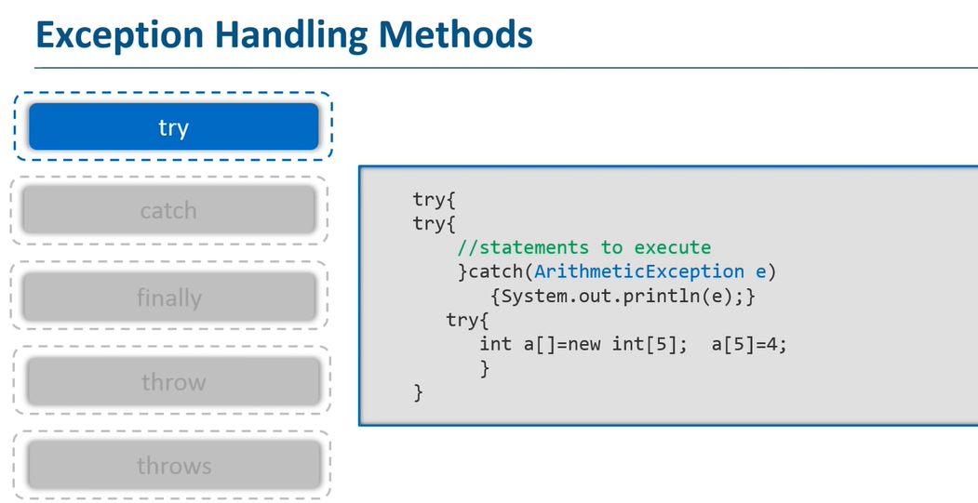

Slide 21
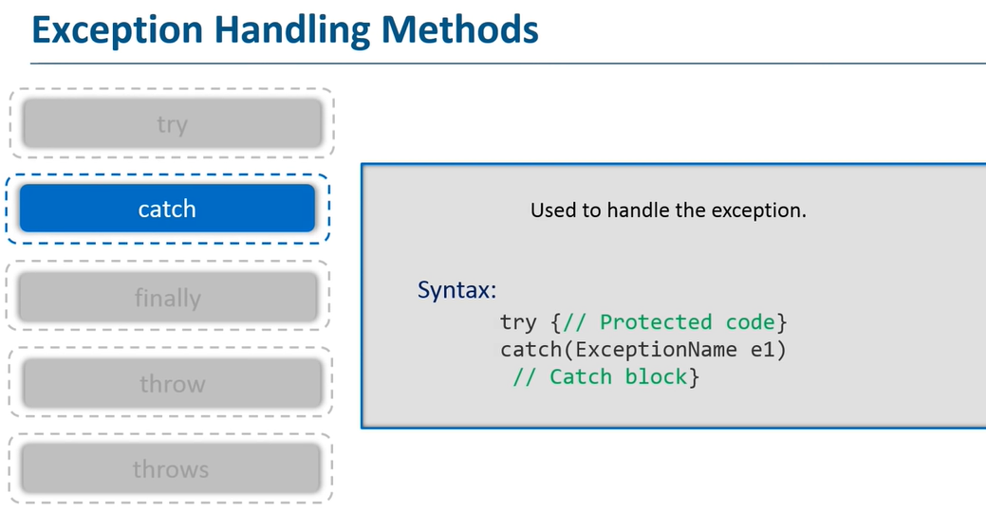

Slide 22
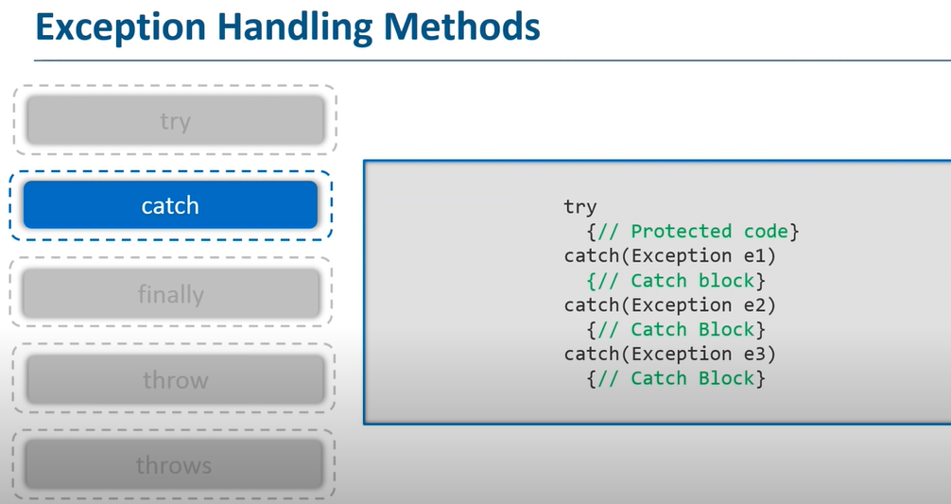

Slide 23
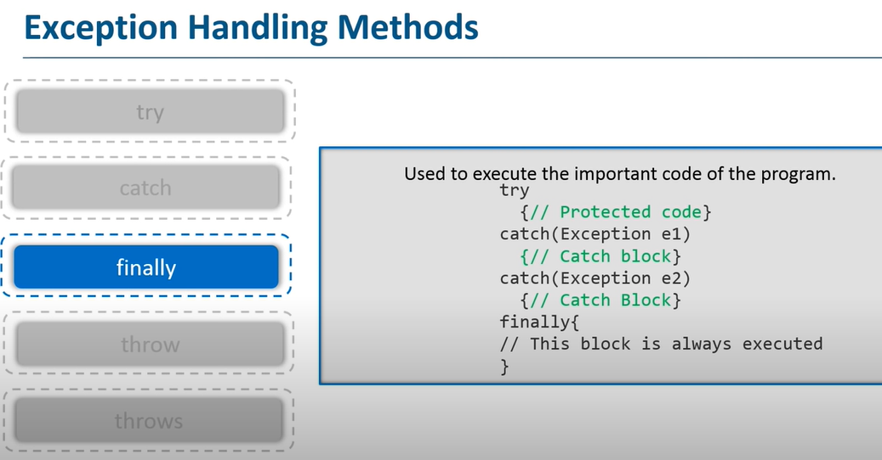

Slide 24
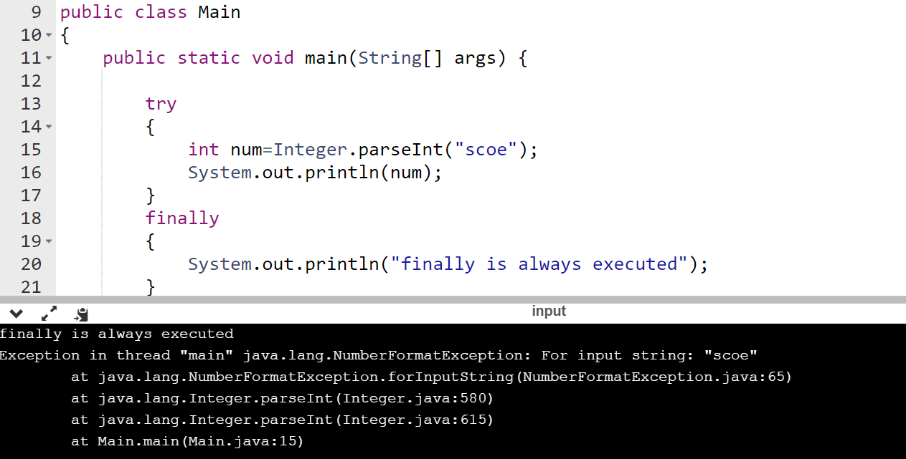

Slide 25
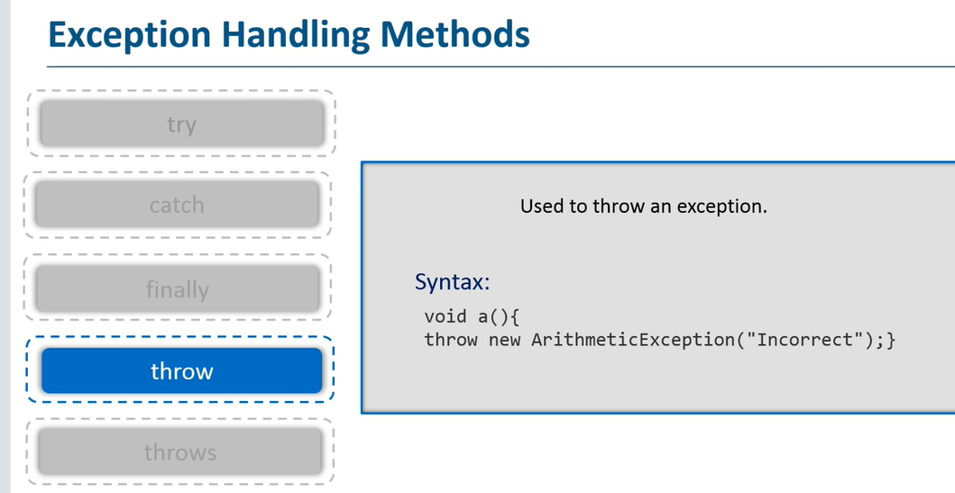

Slide 26
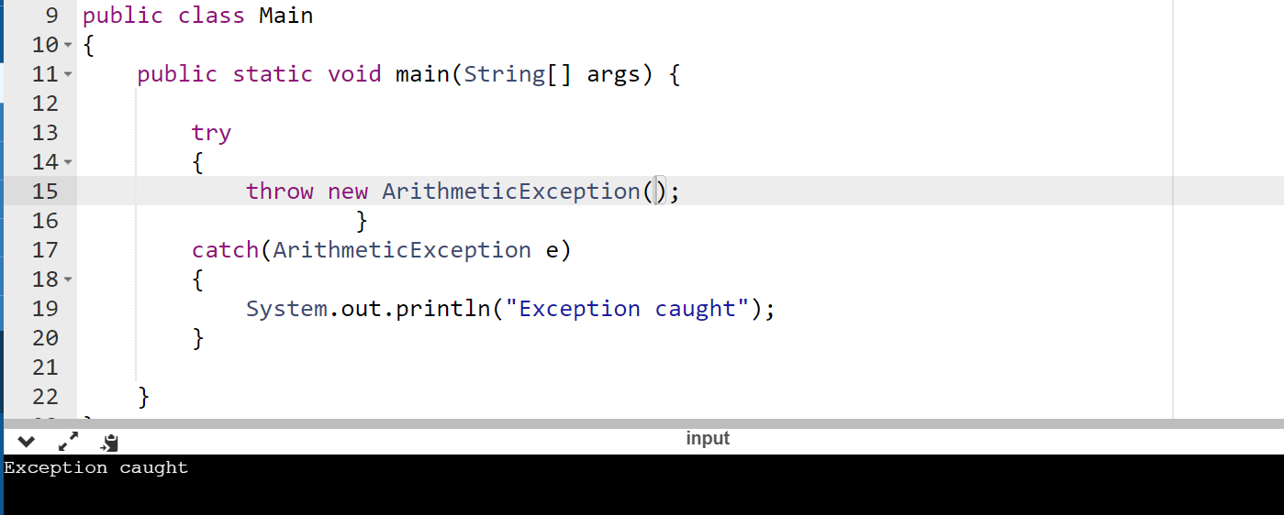

Slide 27
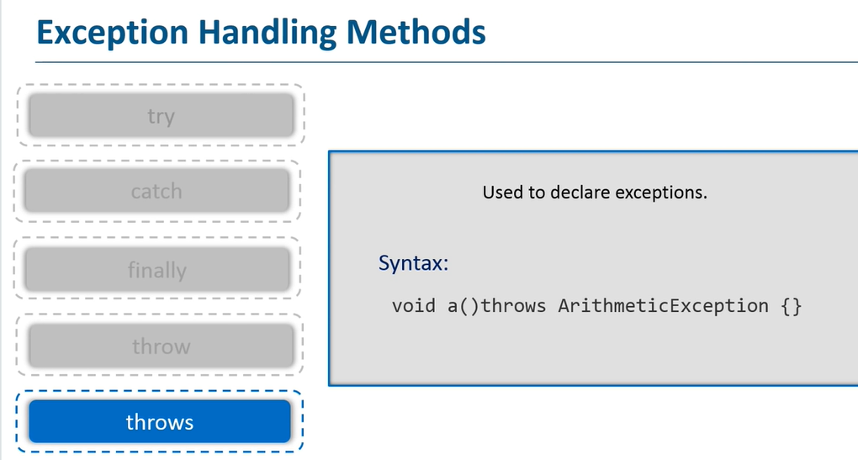

Slide 28
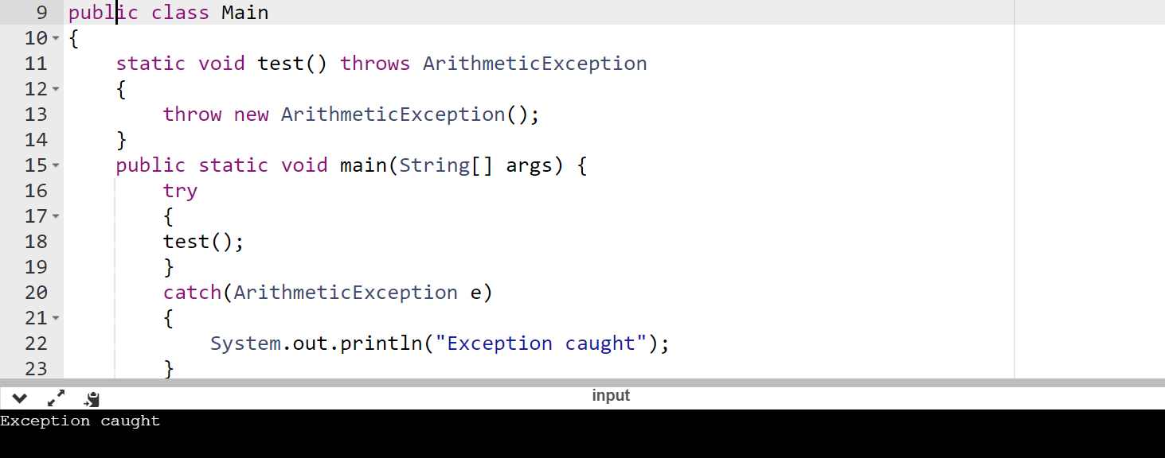

Slide 29
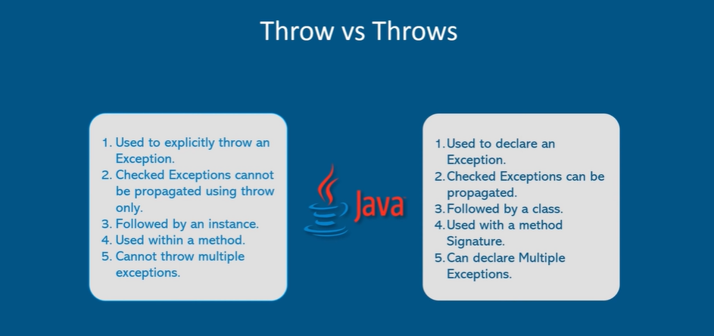

Slide 30
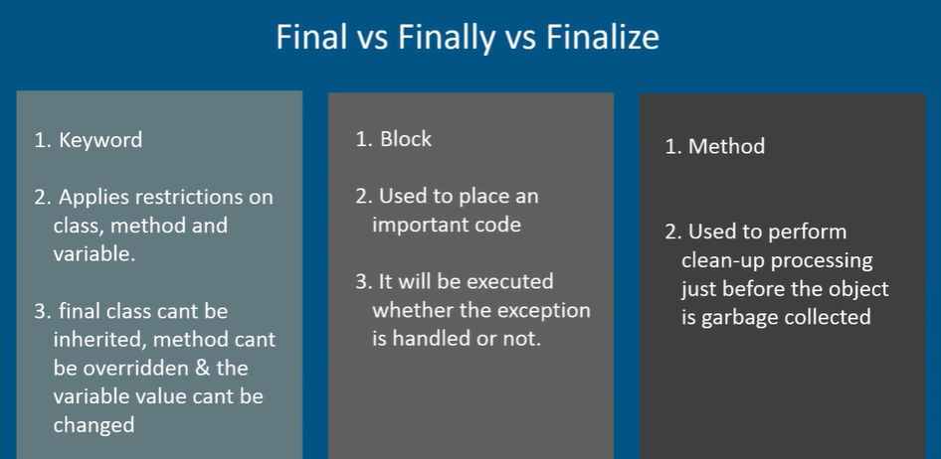

Slide 31
User-Defined Exceptions
Sometimes, the built-in exceptions in Java are not able to describe a certain situation.
In such cases, user can also create exceptions which are called ‘user-defined Exceptions’.

Slide 32
Motivations
When a program runs into a runtime error, the program terminates abnormally.
How can you handle the runtime error so that the program can continue to run or terminate gracefully?

Slide 33
Exception Handling in Java
Topics:
Introduction
Errors and Error handling
Exceptions
Types of Exceptions
Coding Exceptions

Slide 34
Introduction
Users have high expectations for the code we produce.
Users will use our programs in unexpected ways.
Due to design errors or coding errors, our programs may fail in unexpected ways during execution
It is our responsibility to produce quality code that does not fail unexpectedly.
Consequently, we must design error handling into our programs.

Slide 35
Exception
Exception is an abnormal condition
In Java, an exception is an event that disrupts the normal flow of the program

Slide 36
Advantages of Exception Handling
The core advantage of exception handling is to maintain the normal flow of the application. An exception normally disrupts the normal flow of the application that is why we use exception handling.
Suppose there are 10 statements in your program and there occurs an exception at statement 5, the rest of the code will not be executed i.e. statement 6 to 10 will not be executed. If we perform exception handling, the rest of the statement will be executed. That is why we use exception handling in Java.

Slide 37

Lets Take Scenario

Slide 38
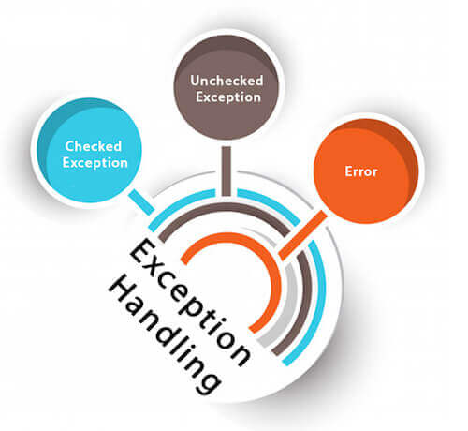
Types of Java Exceptions
There are mainly two types of exceptions: checked and unchecked. According to Oracle, there are three types of exceptions:
Checked Exception
Unchecked Exception
Errors

Slide 39
Difference between Checked and Unchecked Exceptions
1) Checked Exception
The classes which directly inherit Throwable class except RuntimeExceptions are known as checked exceptions e.g. IOException, SQLException etc. Checked exceptions are checked at compile-time.
2) Unchecked Exception
The classes which inherit RuntimeException are known as unchecked exceptions e.g. ArithmeticException, NullPointerException, ArrayIndexOutOfBoundsException etc. Unchecked exceptions are not checked at compile-time, but they are checked at runtime.
3) Error
Error is irrecoverable e.g. OutOfMemoryError, VirtualMachineError, AssertionError etc.

Slide 40
Java Exception Keywords
There are 5 keywords which are used in handling exceptions in Java.
Keyword | Description
try | The "try" keyword is used to specify a block where we should place exception code. The try block must be followed by either catch or finally. It means, we can't use try block alone.
catch | The "catch" block is used to handle the exception. It must be preceded by try block which means we can't use catch block alone. It can be followed by finally block later.
finally | The "finally" block is used to execute the important code of the program. It is executed whether an exception is handled or not.
throw | The "throw" keyword is used to throw an exception.
throws | The "throws" keyword is used to declare exceptions. It doesn't throw an exception. It specifies that there may occur an exception in the method. It is always used with method signature.

Slide 41
Java try-catch block
Java try block
Java try block is used to enclose the code that might throw an exception. It must be used within the method.
If an exception occurs at the particular statement of try block, the rest of the block code will not execute. So, it is recommended not to keeping the code in try block that will not throw an exception.
Java try block must be followed by either catch or finally block.
Syntax of Java try-catch
try{
//code that may throw an exception
}catch(Exception_class_Name ref)
{}

Slide 42
Syntax of try-finally block
Try
{
//code that may throw an exception
}
finally
{
}

Slide 43
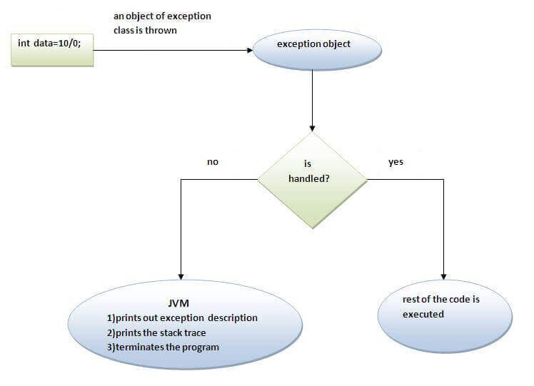
Internal working of java try-catch block

Slide 44
Internal working of java try-catch block
The JVM firstly checks whether the exception is handled or not. If exception is not handled, JVM provides a default exception handler that performs the following tasks:
Prints out exception description.
Prints the stack trace (Hierarchy of methods where the exception occurred).
Causes the program to terminate.
But if exception is handled by the application programmer, normal flow of the application is maintained i.e. rest of the code is executed.

Slide 45
Problem without exception handling
Let's try to understand the problem if we don't use a try-catch block.
Example 1
public class TryCatchExample1 {
public static void main(String[] args) {
int data=50/0; //may throw exception
System.out.println("rest of the code");
}
}
Output:
Exception in thread "main" java.lang.ArithmeticException: / by zero
As displayed in the above example, the rest of the code is not executed (in such case, the rest of the code statement is not printed).
There can be 100 lines of code after exception. So all the code after exception will not be executed.

Slide 46
Solution by exception handling
public class Test {
public static void main(String[] args) {
try
{
int data=50/0; //may throw exception
}
//handling the exception
catch(ArithmeticException e)
{
System.out.println(e);
}
System.out.println("rest of the code");
}
}
Output:
java.lang.ArithmeticException: / by zero
rest of the code
Now, as displayed in the above example, the rest of the code is executed, i.e., the rest of the code statement is printed.

Slide 47
Errors and Error Handling
An Error is any unexpected result obtained from a program during execution.
Unhandled errors may manifest themselves as incorrect results or behavior, or as abnormal program termination.
Errors should be handled by the programmer, to prevent them from reaching the user.

Slide 48
Errors and Error Handling
Some typical causes of errors:
Memory errors (i.e. memory incorrectly allocated, memory leaks, “null pointer”)
File system errors (i.e. disk is full, disk has been removed)
Network errors (i.e. network is down, URL does not exist)
Calculation errors (i.e. divide by 0)

Slide 49
Errors and Error Handling
More typical causes of errors:
Array errors (i.e. accessing element –1)
Conversion errors (i.e. convert ‘q’ to a number)
Can you think of some others?

Slide 50
Errors and Error Handling
Traditional Error Handling
1. Every method returns a value (flag) indicating either success, failure, or some error condition. The calling method checks the return flag and takes appropriate action.
Downside: programmer must remember to always check the return value and take appropriate action. This requires much code (methods are harder to read) and something may get overlooked.

Slide 51
Errors and Error Handling
Traditional Error Handling
Where used: traditional programming languages (i.e. C) use this method for almost all library functions (i.e. fopen() returns a valid file or else null)

Slide 52
Errors and Error Handling
Traditional Error Handling
2. Create a global error handling routine, and use some form of “jump” instruction to call this routine when an error occurs.
Downside: “jump” instruction (GoTo) are considered “bad programming practice” and are discouraged. Once you jump to the error routine, you cannot return to the point of origin and so must (probably) exit the program.

Slide 53
Errors and Error Handling
Traditional Error Handling
Where used: many older programming texts (C, FORTRAN) recommended this method to programmers. Those who use this method will frequently adapt it to new languages (C++, Java).

Slide 54
Errors and Error Handling
Exceptions – a better error handling
Exceptions are a mechanism that provides the best of both worlds.
Exceptions act similar to method return flags in that any method may raise and exception should it encounter an error.
Exceptions act like global error methods in that the exception mechanism is built into Java; exceptions are handled at many levels in a program, locally and/or globally.

Slide 55
Exceptions
Examples:
Checked exceptions include errors such as “array index out of bounds”, “file not found” and “number format conversion”.
Unchecked exceptions include errors such as “null pointer”.

Slide 56
Exceptions
How do you handle exceptions?
Exception handling is accomplished through the “try – catch” mechanism, or by a “throws” clause in the method declaration.
For any code that throws a checked exception, you can handle the exception yourself.

Slide 57
Coding Exceptions
Try-Catch Mechanism
Wherever your code may trigger an exception, the normal code logic is placed inside a block of code starting with the “try” keyword:
After the try block, the code to handle the exception should it arise is placed in a block of code starting with the “catch” keyword.

Slide 58
Coding Exceptions
Try-Catch Mechanism
You may also write an optional “finally” block. This block contains code that is ALWAYS executed, either after the “try” block code, or after the “catch” block code.
Finally blocks can be used for operations that must happen no matter what (i.e. cleanup operations such as closing a file)

Slide 59
Coding Exceptions
Example
try { … normal program code } catch(Exception e) { … exception handling code }

Slide 60
Exceptions
Unexpected conditions
Disrupt normal flow of program
With exception handling, we can develop more robust programs

Slide 61
Exceptions
Exceptions are thrown
And can be caught

Slide 62
What is Exception
An exception is an event, which occurs during the execution of a program, that disrupts the normal flow of the program's instructions.
When an error occurs within a method, the method creates an object and hands it off to the runtime system. ...
This block of code is called an exception handler.

Slide 63
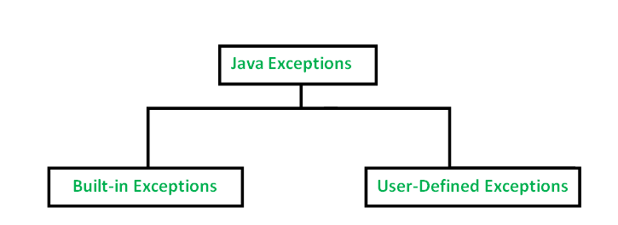
Types of Exception in Java with Examples
Java defines several types of exceptions that relate to its various class libraries. Java also allows users to define their own exceptions.

Slide 64
Built-in exceptions.
These exceptions are suitable to explain certain error situations. Below is the list of important built-in exceptions in Java.
are the exceptions which are available in Java libraries

Slide 65
Exception Types

Slide 66
System Errors
System errors are thrown by JVM and represented in the Error class. The Error class describes internal system errors. Such errors rarely occur. If one does, there is little you can do beyond notifying the user and trying to terminate the program gracefully.

Slide 67
Exceptions
Exception describes errors caused by your program and external circumstances. These errors can be caught and handled by your program.

Slide 68
Runtime Exceptions
RuntimeException is caused by programming errors, such as bad casting, accessing an out-of-bounds array, and numeric errors.

Slide 69
Built-in exceptions
ArithmeticException : It is thrown when an exceptional condition has occurred in an arithmetic operation.
ArrayIndexOutOfBoundsException : It is thrown to indicate that an array has been accessed with an illegal index. The index is either negative or greater than or equal to the size of the array.
ClassNotFoundException :This Exception is raised when we try to access a class whose definition is not found
FileNotFoundException :This Exception is raised when a file is not accessible or does not open.
IOException:It is thrown when an input-output operation failed or interrupted
InterruptedException:It is thrown when a thread is waiting , sleeping , or doing some processing , and it is interrupted.
NoSuchFieldException:It is thrown when a class does not contain the field (or variable) specified

Slide 70
Built-in exceptions
NoSuchMethodException:It is thrown when accessing a method which is not found.
NullPointerException:This exception is raised when referring to the members of a null object. Null represents nothing.
NumberFormatException:This exception is raised when a method could not convert a string into a numeric format.
RuntimeException:This represents any exception which occurs during runtime.
StringIndexOutOfBoundsException:It is thrown by String class methods to indicate that an index is either negative than the size of the string.

Slide 71
Catching Exceptions
try {
statements; // Statements that may throw exceptions
}
catch (Exception1 exVar1)
{
handler for exception1;
}
catch (Exception2 exVar2)
{
handler for exception2;
}
...
catch (ExceptionN exVar3)
{
handler for exceptionN;
}

Slide 72
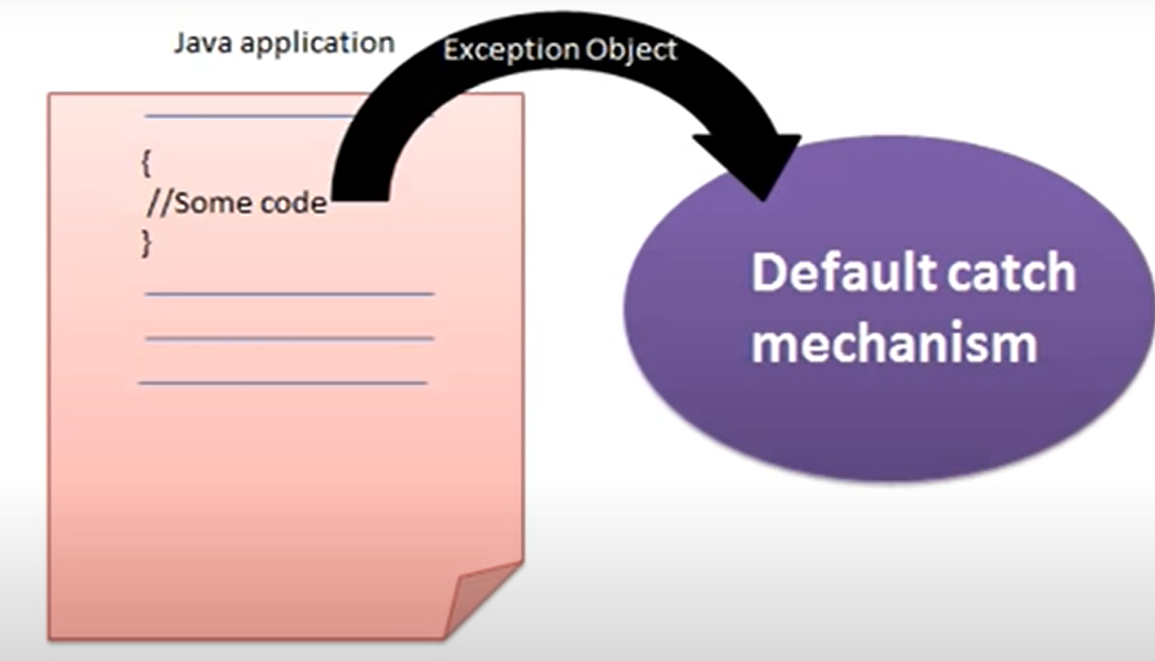

Slide 73
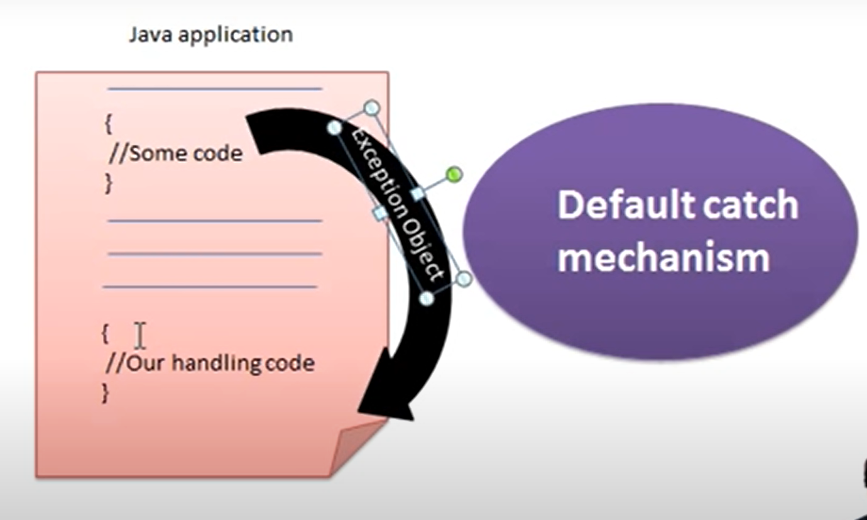

Slide 74
// Java program to demonstrate ArithmeticException
public class ArithmeticException_Demo
{
public static void main(String args[])
{
try {
int a = 30, b = 0;
int c = a/b; // cannot divide by zero
System.out.println ("Result = " + c);
}
catch(ArithmeticException e) {
System.out.println ("Can't divide a number by 0");
}
}
}
Output :
Can't divide a number by 0

Slide 75
NullPointer Exception
//Java program to demonstrate NullPointerException
public class NullPointer_Demo
{
public static void main(String args[])
{
try {
String a = null; //null value
System.out.println(a.charAt(0));
}
catch(NullPointerException e)
{
System.out.println("NullPointerException..");
}
}
}
Output :
NullPointerException..
//Java String charAt() Method : The charAt() method returns the character at the specified index in a string.

Slide 76
StringIndexOutOfBound Exception
public class Main
{
public static void main(String args[])
{
try {
String a = “Hello scoe"; // length is 10
char c = a.charAt(15); // accessing 15th element
System.out.println(c);
}
catch(StringIndexOutOfBoundsException e)
{
System.out.println("StringIndexOutOfBoundsException");
}
}
}
Output:
StringIndexOutOfBoundsException

Slide 77
FileNotFound Exception
import java.io.File;
import java.io.FileNotFoundException;
import java.io.FileReader;
public class File_notFound_Demo {
public static void main(String args[])
{
try {
// Following file does not exist
File file = new File("E://file.txt");
FileReader fr = new FileReader(file);
}
catch (FileNotFoundException e) {
System.out.println("File does not exist");
}
}
}
Output :File does not exist

Slide 78
NumberFormat Exception
public class NumberFormat_Demo
{
public static void main(String args[])
{
try {
// “SCOE" is not a number
int num = Integer.parseInt (“SCOE") ;
System.out.println(num);
}
catch(NumberFormatException e) {
System.out.println("Number format exception");
}
}
}
Output :
Number format exception
// The method generally used to convert String to Integer in Java is parseInt(). This method belongs to Integer class in java.lang package.

Slide 79
ArrayIndexOutOfBounds Exception
public class ArrayIndexOutOfBound_Demo
{
public static void main(String args[])
{
try{
int a[] = new int[5];
a[6] = 9; // accessing 7th element in an array of size 5
}
catch(ArrayIndexOutOfBoundsException e){
System.out.println ("Array Index is Out Of Bounds");
}
}
}
Output :
Array Index is Out Of Bounds

Slide 80
User-Defined Exceptions
Sometimes, the built-in exceptions in Java are not able to describe a certain situation.
In such cases, user can also create exceptions which are called ‘user-defined Exceptions’.
Following steps are followed for the creation of user-defined Exception.
The user should create an exception class as a subclass of Exception class. Since all the exceptions are subclasses of Exception class, the user should also make his class a subclass of it. This is done as:
class MyException extends Exception
We can write a default constructor in his own exception class.
MyException(){}

Slide 81
We can also create a parameterized constructor with a string as a parameter.
We can use this to store exception details. We can call super class(Exception) constructor from this and send the string there.
MyException(String str)
{
super(str);
}
To raise exception of user-defined type, we need to create an object to his exception class and throw it using throw clause, as
MyException me = new MyException(“Exception details”);
throw me;

Slide 82
The following program illustrates how to create own exception class MyException.
Details of account numbers, customer names, and balance amounts are taken in the form of three arrays.
In main() method, the details are displayed using a for-loop. At this time, check is done if in any account the balance amount is less than the minimum balance amount to be kept in the account.
If it is so, then MyException is raised and a message is displayed “Balance amount is less”.

Slide 83
// Java program to demonstrate user defined exception
// This program throws an exception whenever balance
// amount is below Rs 1000
public class MyException extends Exception
{
//store account information
private static int accno[] = {1001, 1002, 1003, 1004};
private static String name[] = {"Nish", "Shubh", "Sush", "Abhi", "Akash"};
private static double bal[] = {10000.00, 12000.00, 5600.0, 999.00, 1100.55};
// default constructor
MyException() { }
// parametrized constructor
MyException(String str) { super(str); }
// write main()
public static void main(String[] args)
{
try {
// display the heading for the table
System.out.println("ACCNO" + "\t" + "CUSTOMER" +
"\t" + "BALANCE");
// display the actual account information
for (int i = 0; i < 5 ; i++)
{
System.out.println(accno[i] + "\t" + name[i] + "\t" + bal[i]);
// display own exception if balance < 1000
if (bal[i] < 1000)
{
MyException me =
new MyException("Balance is less than 1000");
throw me;
}
}
} //end of try
catch (MyException e) {
e.printStackTrace();
}
}
}
Output :
ACCNO CUSTOMER BALANCE
Nish 10000.0
Shubh 12000.0
Sush 5600.0
Abhi 999.0
MyException: Balance is less than 1000 at MyException.main(MyException.java:39)

Slide 84
Summary
Exceptions are a powerful error handling mechanism.
Exceptions in Java are built into the language.
Exceptions can be handled by the programmer (try-catch), or handled by the Java environment (throws).

Slide 85
Assignment No. 6
Title: Exception handling
Aim: Implement a program to handle Arithmetic exception, Array Index Out Of Bounds. The user enters two numbers Num1 and Num2. The division of Num1 and Num2 is displayed. If Num1 and Num2 were not integers, the program would throw a Number Format Exception. If Num2 were zero, the program would throw an Arithmetic Exception and Display the exception.
Objectives: To understand Exception handling
Theory:
What is an exception
2. Exception Handling
3. Exception Types
4. Throw , Try and Catch Blocks

Slide 86
public class Main {
public static void main(String[] args) {
try {
int array[] = new int[10];
array[9] = 30 / 6;
System.out.println(+array[9]);
}
catch (ArithmeticException e) {
System.out.println(e.getMessage());
}
catch (ArrayIndexOutOfBoundsException e) {
System.out.println(e.getMessage());
}
}
}
Output : 5

Slide 87
public class Main {
public static void main(String[] args)
{
try {
int array[] = new int[10];
array[9] = 30 / 0;
System.out.println(+array[9]);
}
catch (ArithmeticException e)
{
System.out.println(e.getMessage());
}
catch (ArrayIndexOutOfBoundsException e)
{
System.out.println(e.getMessage());
}
}
}
Output :
/ by zero
// ArithmeticException because we are trying to divide a number by 0

Slide 88
public class Main {
public static void main(String[] args) {
try {
int array[] = new int[10];
array[10] = 30 / 6;
System.out.println(+array[9]);
}
catch (ArithmeticException e) {
System.out.println(e.getMessage());
}
catch (ArrayIndexOutOfBoundsException e) {
System.out.println(e.getMessage());
}
}
}
Index 10 out of bounds for length 10
ArrayIndexOutOfBoundsException because we have declared a new integer array with array bounds 0 to 9 and we are trying to assign a value to index 10.
The associativity of the assignment operator = is right to left, so an ArithmeticException is thrown first with the message / by zero.

Slide 89
Handle Multiple Exceptions in a catch Block
we can now catch more than one type of exception in a single catch block.
Each exception type that can be handled by the catch block is separated using a vertical bar or pipe |.
Its syntax is:
try {
// code
} catch (ExceptionType1 | Exceptiontype2 ex) {
// catch block
}

Slide 90
Example 2: Multi-catch block
class Main {
public static void main(String[] args) {
try {
int array[] = new int[10];
array[10] = 30 / 0;
} catch (ArithmeticException | ArrayIndexOutOfBoundsException e) {
System.out.println(e.getMessage());
}
}
}
Output
/ by zero
Catching multiple exceptions in a single catch block reduces code duplication and increases efficiency.
The bytecode generated while compiling this program will be smaller than the program having multiple catch blocks as there is no code redundancy.

Slide 91
Catching base Exception
//Example 3: Catching base exception class only
class Main {
public static void main(String[] args) {
try {
int array[] = new int[10];
array[10] = 30 / 0;
} catch (Exception e) {
System.out.println(e.getMessage());
}
}
}
Output :/ by zero
We know that all the exception classes are subclasses of the Exception class. So, instead of catching multiple specialized exceptions, we can simply catch the Exception class.
When catching multiple exceptions in a single catch block, the rule is generalized to specialized.
This means that if there is a hierarchy of exceptions in the catch block, we can catch the base exception only instead of catching multiple specialized exceptions.
Let’s take an example.

Slide 92
//Program to throw implement division and throw exceptions
import java.util.*;
public class NAexception
{
public static void main(String args[])
{
Scanner scr=new Scanner(System.in);
int num1,num2,q;
try
{
System.out.println("\nEnter the value of first integer : ");
num1=Integer.parseInt(scr.next());
System.out.println("\nEnter the value of second integer : ");
num2=Integer.parseInt(scr.next());
q=num1/num2;
System.out.println("\nQuotient is : "+q);
}
catch(NumberFormatException e)
{
System.out.println(e);
}
catch(ArithmeticException e)
{
System.out.println(e );
}
}
}
Enter the value of first integer :25
Enter the value of second integer : 5
Quotient is : 5

